Slide 1
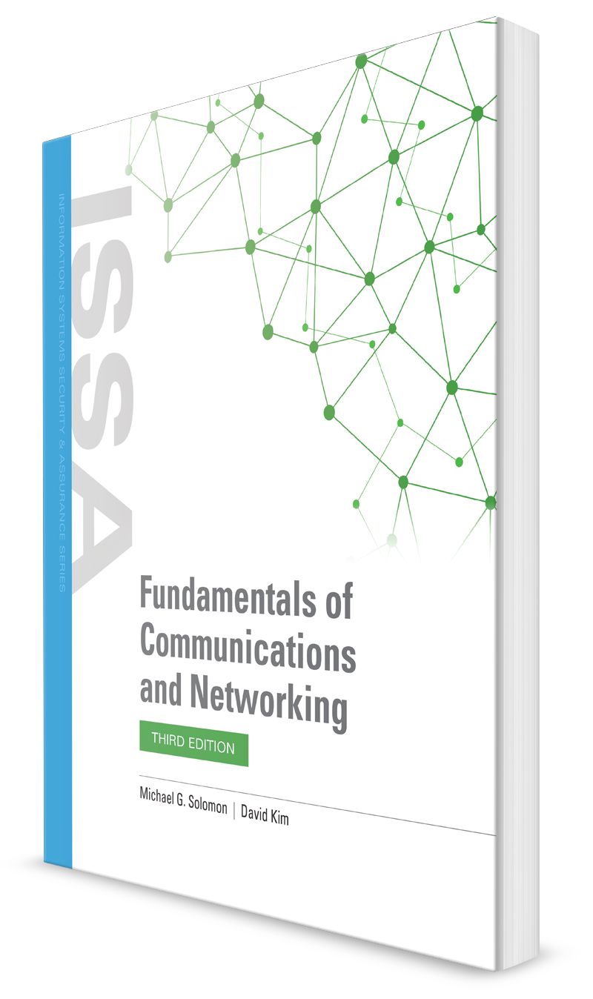
Wireless Networks
CHAPTER 10

Slide 2
Learning Objective(s) and Key Concepts
Learning Objective(s)
Key Concepts
Describe wireless and wide area networking used to increase business productivity.
How wireless networking benefits users and organizations
Standards in the IEEE 802.11 wireless family
WLAN security
Designing and laying out a WLAN network
Conducting a radio frequency (RF) site survey

Slide 3
Wired Versus Wireless
Mobility
Cost
Scalability
Two primary types of wireless network connections in use today: Wi-Fi and cellular

Slide 4
IEEE 802.11 Family of Standards (1 of 2)
IEEE Standard | Defines | Approval Date
802.11 | 2 Mbps wireless networking | 1997
802.11a | 54 Mbps wireless networking (5 GHz band) | 1999
802.11b | 11 Mbps wireless networking (2.4 GHz band) | 1999
802.11g | 54 Mbps wireless networking (2.4 GHz band) | 2003
802.11i | Security improvements to 802.11x standards | 2004
802.11n | 600 Mbps wireless networking (2.4 and 5 GHz band) | 2009
802.11ac | 1300 Mbps wireless networking (5 GHz band) | 2014
802.11ax | 10,000 Mbps wireless networking (2.4, 5, and 6 GHz band) | 2019

Slide 5
IEEE 802.11 Family of Standards (2 of 2)
IEEE Standard | Defines | Approval Date
802.15 | Wireless personal area network (WPAN), a wireless version of a personal area network (PAN) (a network of devices in close proximity to one another) | 2008
802.16 | WirelessMAN (WMAN)—WiMAX | 2005
802.20 | Fixed wireless broadband | 2004
802.22 | Wireless regional area network (WRAN) | 2011

Slide 6
The IEEE 802.11a and 802.11b WLAN Standards
802.11a
Typical throughput in mid-20 Mbps
Restricted almost to line of sight; cannot penetrate as far as 802.11b/g
Uses orthogonal frequency-division multiplexing (OFDM), Unlicensed National Information Infrastructure (UNII), multipath propagation, IEEE 802.11a modulation
802.11b/Legacy
The first wireless standard in use
Less susceptible to corruption
Supported two data transfer speeds—1 or 2 megabits per second (Mbps)
Scaled back as signal quality decreased

Slide 7
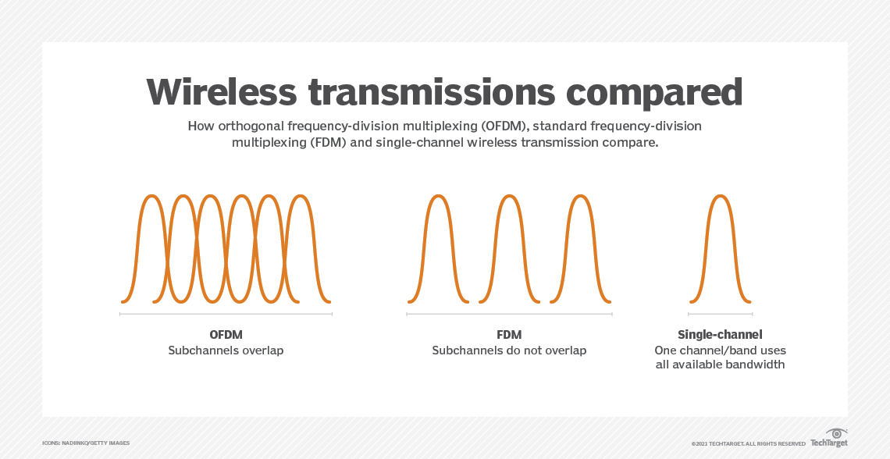
OFDM
Orthogonal frequency-division multiplexing is a method of data transmission where a single information stream is split among several closely spaced narrowband subchannel frequencies instead of a single Wideband channel frequency

Slide 8
OFDM
OFDM builds on simpler frequency-division multiplexing.
In FDM, the total data stream is divided into several subchannels, but the frequencies of the subchannels are spaced farther apart so they do not overlap or interfere.
With OFDM, the subchannel frequencies are close together and overlapping but are still orthogonal, or separate, in that they are carefully chosen and modulated so that the interference between the subchannels is canceled out.

Slide 9
The IEEE 802.11g WLAN Standard
Supports high-speed (up to 54 Mbps) wireless networking over relatively short distances
Incorporates OFDM to achieve higher data transfer rates
Can scale back to 11 Mbps or lower
Backward-compatible with 802.11b
Compatible with 802.11a if WAP broadcasts in both 2.4 GHz and 5 GHz ranges

Slide 10
The IEEE 802.11n WLAN Standard
Most wireless adapters support 802.11n
Backward-compatible with 802.11a/b/g
Throughput to 450 Mbps
Supports multiple MIMO spatial streams
MIMO improves data throughput and range without changing the nominal bandwidth or transmission power of WLAN devices

Slide 11
MU-MIMO
MU-MIMO allows APs and their many antennas to transmit to multiple client devices at one time.
That helps increase airtime efficiency so every client—regardless of what version of 802.11 it is running—gets the amount of airtime it's supposed to get based on the technology supported.
A lower-speed client no longer slows the overall downlink throughput for others on the network.

Slide 12
MU-MIMO
MU-MIMO's benefits include:
There are no more bottlenecks.
Devices get on and off the network quicker, allowing more devices to be served.
Legacy devices—those that run 802.11a/b/g/n—will see a bump in performance.
Due to the speed of MU-MIMO, 802.11ac Wave 2 clients will get on and off the network quicker.
802.11ac Wave 2-enabled smartphones, laptops, and tablets will jump on the 5-GHz band, leaving 2.4-GHz bands for older devices.

Slide 13
The IEEE 802.11ac and 802.11ax WLAN Standards
802.11ac
Up to 1300 Mbps throughput
RF bandwidth up to 160 MHz
More MIMO spatial streams
High-density modulation in the form of 256 quadrature amplitude modulation (QAM)
Operates in the 5 GHz band, which is less crowded than the 2.4 GHz band
802.11ax
Marketed as Wi-Fi 6
Up to 10,000 Mbps throughput
RF bandwidth up to 160 MHz; more MIMO and MU-MIMO
High-density modulation in the form of 1024 QAM
Operates in the 2.4 GHz and 5 GHz bands; Wi-Fi 6E devices also operate in the 6 GHz band

Slide 14
WLAN Security
Authentication and access control
Open System Authentication (OSA)
Shared Key Authentication (SKA)
Extensible Authentication Methods
Extensible Authentication Protocol (EAP)
802.11x network
Authentication framework
Authentication algorithm
Data frame encryption

Slide 15
Security Threats to WLANs
Client-to-client attacks
Denial of service (DoS) attacks
Insertion attacks
Interception attacks

Slide 16
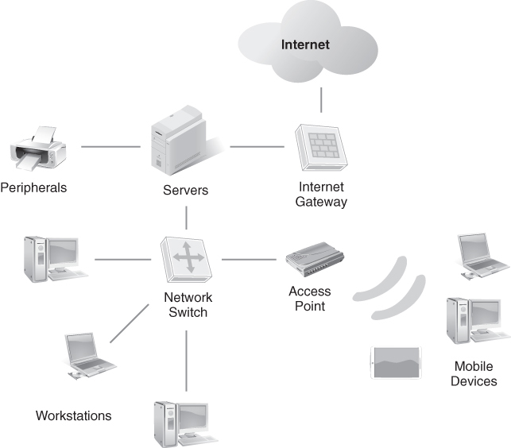
A Network with an Internet Gateway and Wired and Wireless Segments
FIGURE 10-2 A network with an Internet gateway and wired and wireless segments.

Slide 17
IEEE 802.1X Security
802.1X standard
Incorporated the IEEE 802.1X authentication framework
Provides centralized authentication of wireless users or stations
Can work simultaneously with multiple authentication algorithms
Is the same framework defined for all 802.X networking

Slide 18
IEEE 802.1X Authentication Methods
EAP Type | Developer | Certificates Required | Dynamic WEP Keys | Authentication | Security Level
MD-5 | Ron Rivest at MIT | Client/server | No | One-way | Low
PEAP | Cisco Systems, Microsoft, and RSA Security | Server | Yes | Mutual | High
TLS | Internet Engineering Task Force (IETF) | Client/server | Yes | Mutual | Very High
TTLS | Funk Software and Certicom | None | Yes | Mutual | High

Slide 19
IEEE 802.1X Authentication Process (1 of 2)
When a wireless station connects to a WLAN, it transmits an EAP-start frame, which is a request to enter the network over the wireless medium
The access point receiving the EAP-start frame replies with an EAP-request identity frame. In other words, the access point is asking the station to identify itself
The station responds with an EAP-response frame containing its MAC address and other identifying information, which is really intended for the AAA server. After receiving the EAP-response frame and passing it along to the AAA server, the access point blocks any traffic from the station that is not EAP-related

Slide 20
IEEE 802.1X Authentication Process (2 of 2)
The AAA server then verifies the station’s identity information using an authentication algorithm, a digital certificate, or another EAP authentication method
An accept-or-reject frame is transmitted by the AAA server to the access point to indicate that it was able or unable to verify the identity information provided by the wireless station
Depending on the type of frame received from the AAA server, the access point transmits either an EAP-success or an EAP-rejection frame to the requesting station. If the AAA server successfully authenticated the station’s identity information, the access point allows the station’s normal traffic to pass to the network. If the station’s information is rejected, its port is locked in EAP-only status

Slide 21
EAP Types
MD5
Protected Extensible Authentication Protocol (PEAP)
EAP-Transport Layer Security (EAP-TLS)
EAP-Tunneled Transport Layer Security (EAP-TTLS)

Slide 22
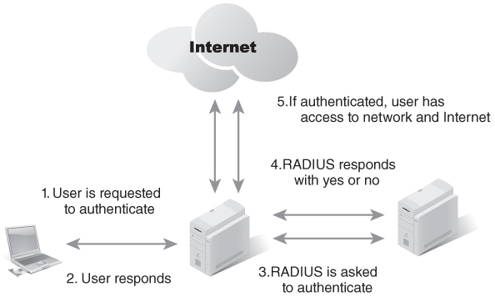
A RADIUS Server Provides Basic-Level Authentication on a Network
FIGURE 10-4 A RADIUS server provides basic-level authentication on a network.

Slide 23
Encryption and Data Privacy
Symmetric encryption
Asymmetric encryption
Digital signatures
IEEE 802.11i

Slide 24
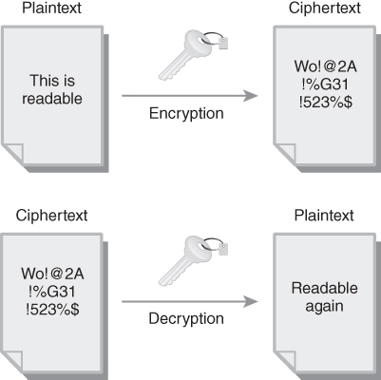
Symmetric Encryption Uses the Same Private Key to Encrypt and Decrypt a Document
FIGURE 10-5 Symmetric encryption uses the same private key to encrypt and decrypt a document.

Slide 25
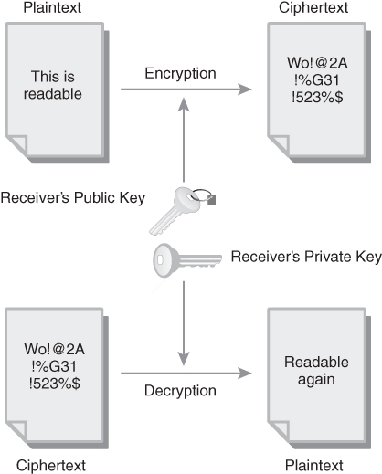
Asymmetric Encryption Uses One Key to Encrypt and Another Key to Decrypt a Document
FIGURE 10-6 Asymmetric encryption uses one key to encrypt and another key to decrypt a document.

Slide 26
Security Protocols and Access Control
Wired Equivalent Privacy (WEP)
Wi-Fi Protected Access (WPA)
Wi-Fi Protected Access 2 (WPA2)
Wi-Fi Protected Access 3 (WPA3)
Media Access Control (MAC) layer address filtering

Slide 27
Security Practices
SSID broadcast
Authentication
Open authentication
Preshared key (PSK)
Extensible Authentication Protocol (EAP)
MAC address filtering
Encryption
Filtering traffic on an AP

Slide 28
Extensible Authentication Protocol (EAP)
EAP is an authentication framework, not a specific authentication mechanism.
It provides some common functions and negotiation of authentication methods called EAP methods.
There are currently about 40 different methods defined. Methods defined in IETF RFCs include EAP-MD5, EAP-TLS, EAP-IKEv2 etc.

Slide 29
Other Security Practices
Change the default SSID and passwords
Keep your AP firmware up to date
Conduct Wi-Fi security audits regularly
Use a wireless intrusion prevention system (WIPS)

Slide 30
Unauthorized Access to Shared Resources
Wi-Fi is entryway chosen by intruders to gain access to information assets on wired network
Implement additional access authentication and authorization on APs

Slide 31
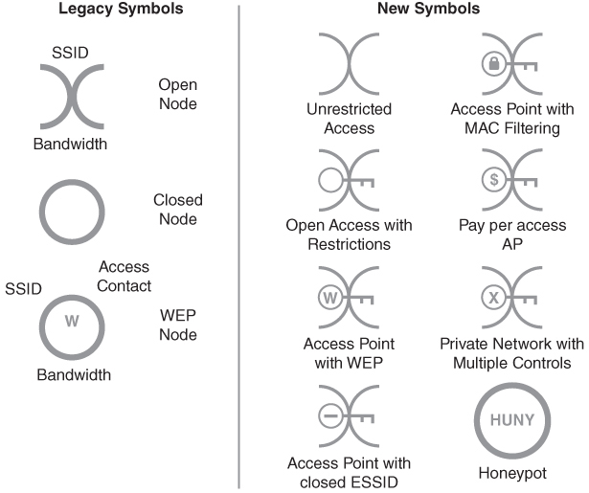
War Chalking Symbols
FIGURE 10-7 War chalking symbols.

Slide 32
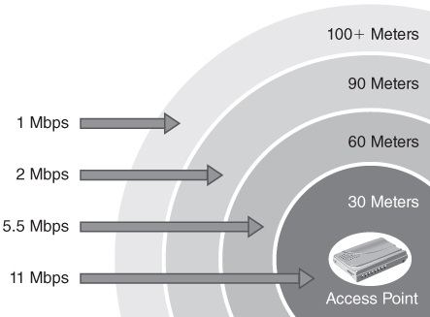
WLAN Planning and Design: RF Design Issues
Competing devices
Distance
Metal boxes
Stationary objects
Shared bandwidth
FIGURE 10-8 The bandwidth of an 802.11b signal fades as its range increases.

Slide 33
WLAN Planning and Design: Capacity and Coverage
Coverage
Signal strength to network nodes
Capacity
The number of nodes and amount of shared bandwidth available to each node
WLAN designer goal: Strike a balance between capacity and coverage
Consequences
If design focuses solely on coverage, there may not be enough bandwidth available to support every node
If design emphasizes capacity, the WLAN may provide adequate coverage in the near term but may fail to provide adequate coverage as nodes are added
Also must consider WLAN mode (ad hoc, infrastructure) and topology

Slide 34
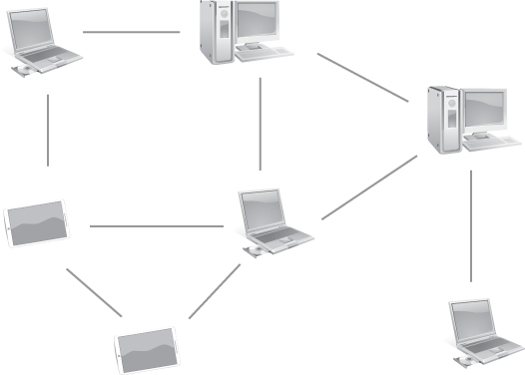
A WLAN Configured in Ad Hoc Mode
FIGURE 10-9 A WLAN configured in ad hoc mode.

Slide 35
WLAN Planning and Design: Speed and Distance Requirements
Choosing the right APs
Where are users located?
What applications will users use (email on the Internet, productivity, video conferencing)?
Distance issues
A fast network that does not cover all necessary areas is not functional
Create a map of intended coverage
Plot where users will be
Determine if you will support indoor, outdoor, or both
Determine whether coverage needs to span multiple floors in a building

Slide 36
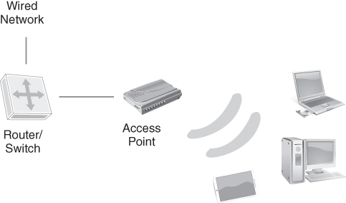
Basic Set Service (BSS) Requires the Inclusion of an Access Point (Base Station)
FIGURE 10-10 A BSS requires the inclusion of an access point (base station).

Slide 37
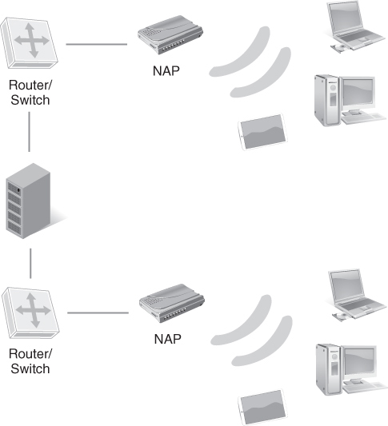
Multiple Access Points in a Single WLAN Create an ESS Topology
FIGURE 10-11 Multiple access points in a single WLAN create an ESS topology.

Slide 38
WLAN Planning and Design: Channel Bandwidth and Bonding
Channel bandwidth
Channel bonding
The width, or range, in MHz that limits how much data a connection can send and receive at a time
The practice of linking channels to get more bandwidth

Slide 39
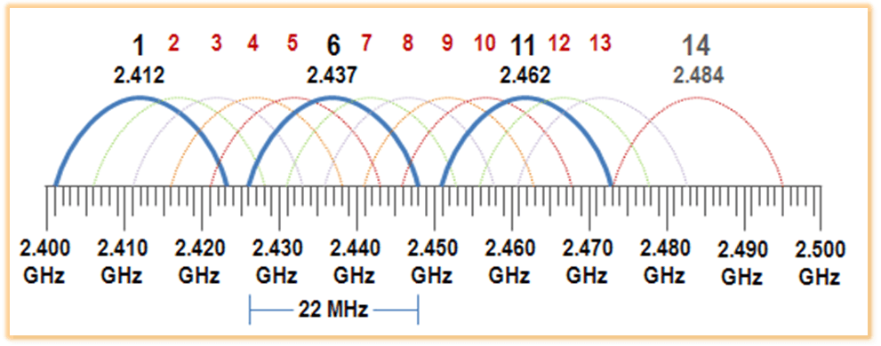
Wifi Channels 2.4GHz

Slide 40
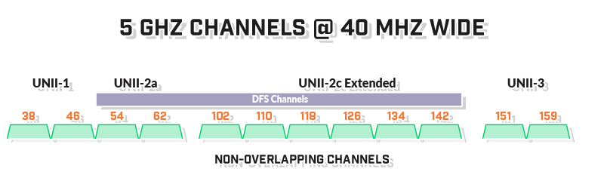
Wifi Channels 5GHz

Slide 41
WLAN Planning and Design: MIMO/MU-MIMO
MIMO
Allows devices to send and receive multiple streams of data simultaneously using multiple antennas
Multiuser multiple-input multiple-output (MU-MIMO)
Allows MIMO devices to send simultaneous data streams to different devices
An extension of single-user MIMO technology
Increases the effective transmission speed of wireless networks

Slide 42
WLAN Planning and Design: Unidirectional/ Omnidirectional
Omnidirectional antennas
Transmit and receive to and from all directions
Good choice for APs in central locations
Unidirectional antennas
Transmit and receive to and from only devices that are physically located within a specific arc, such as 90 degrees or 180 degrees
Good choice for providing limited coverage, such as near an external wall

Slide 43
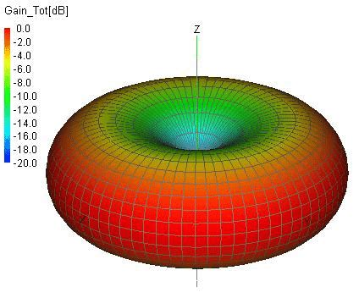
Omnidirectional antennas

Slide 44
Performing a Site Survey
Qualify the proposed site
Not every site will adequately support a wireless network
Verify coverage
Ensure that all proposed node locations are able to connect to the WLAN
Verify capacity
Ensure that all proposed node locations have sufficient signal strength and bandwidth for their network applications

Slide 45
Conducting the Site Tests
Gather documentation
Perform a walk-through
Use a site survey tool
Place stations
Place support equipment
Locate the available power sources

Slide 46
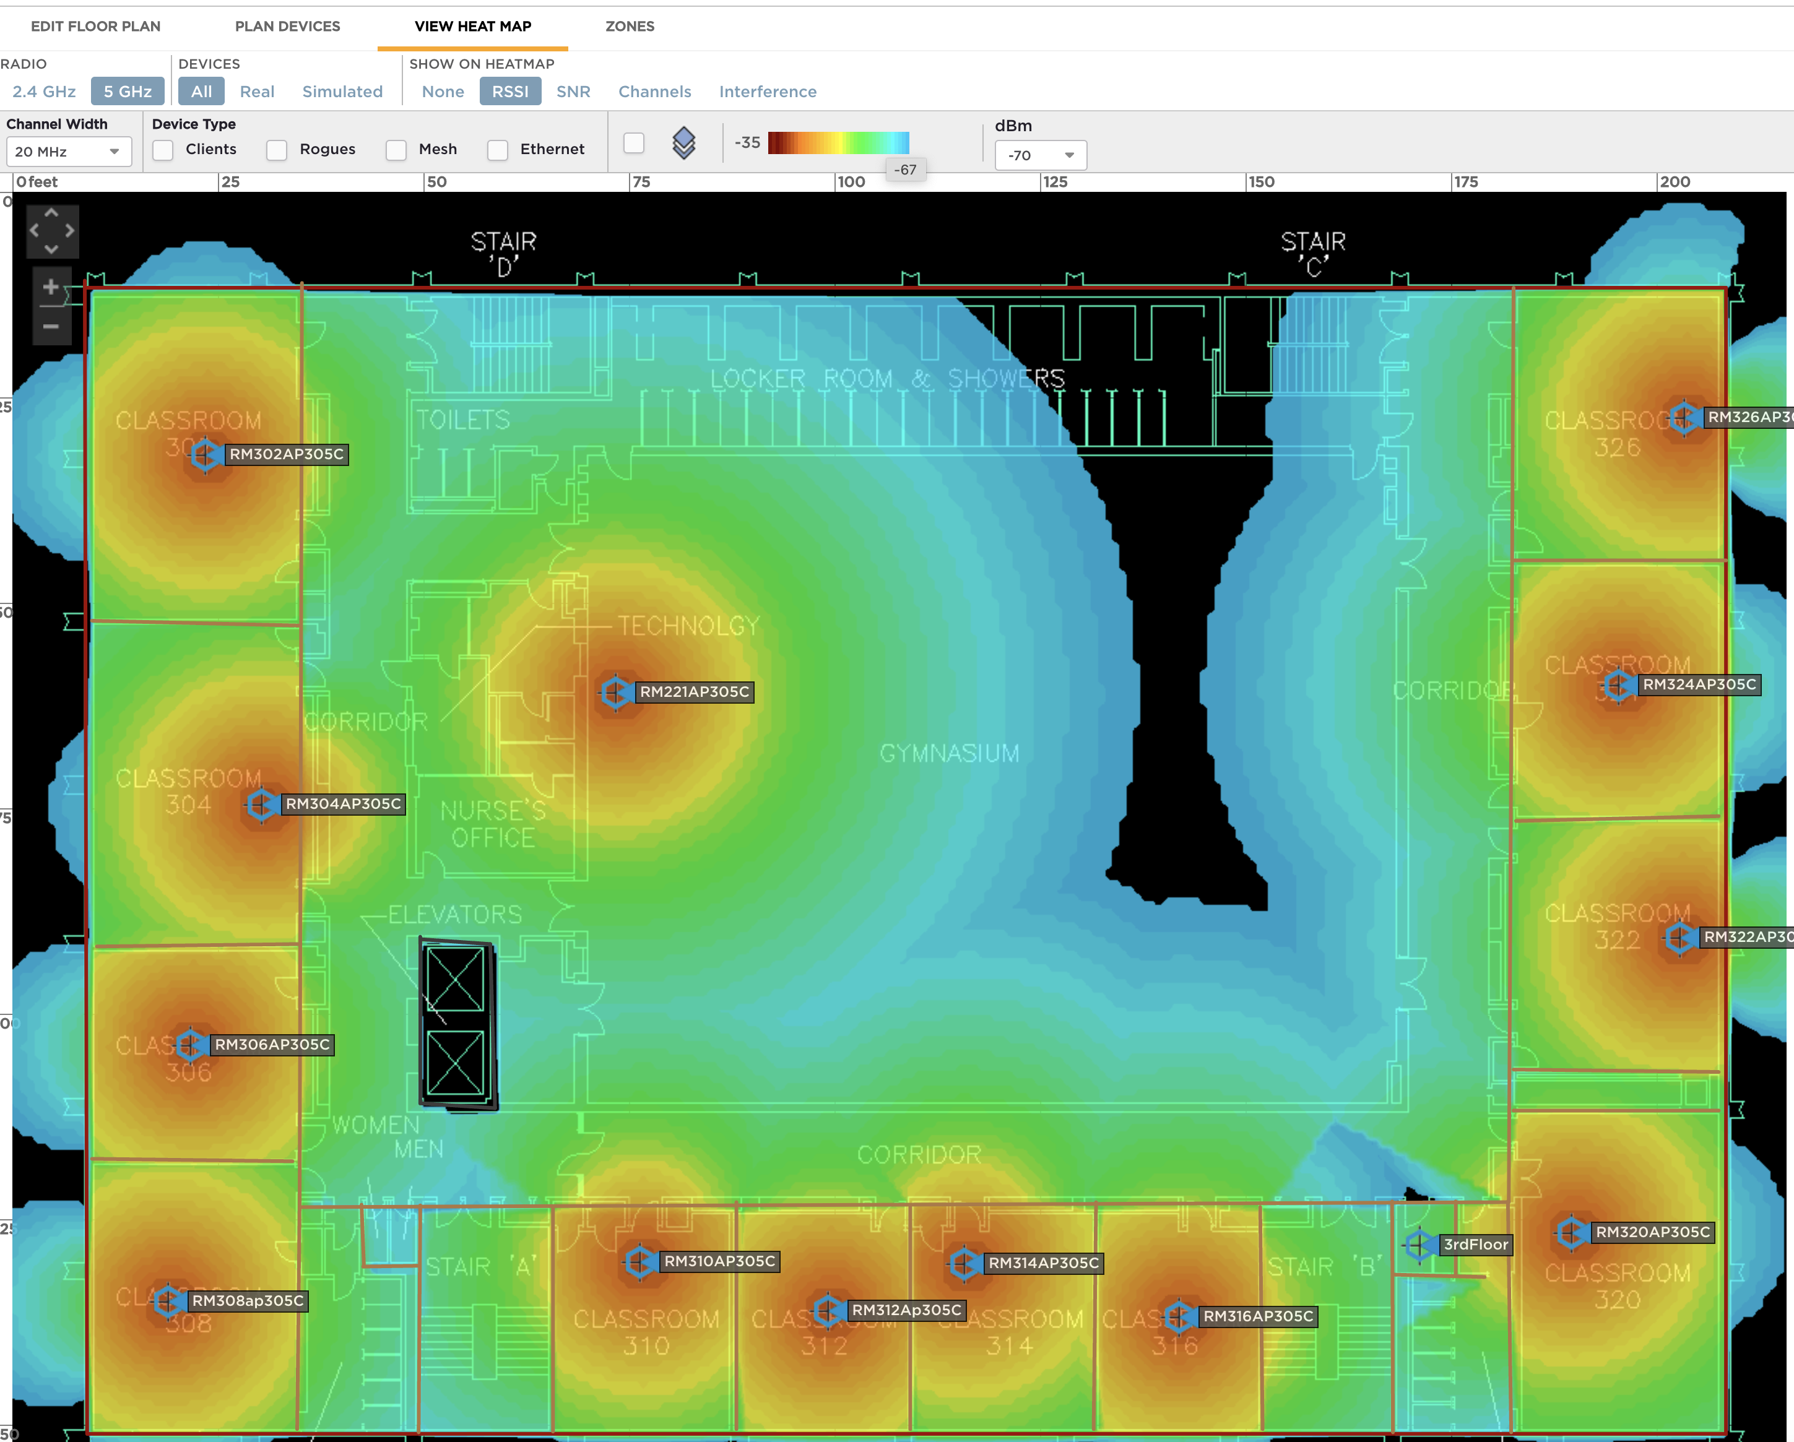
Performing a Site Survey

Slide 47
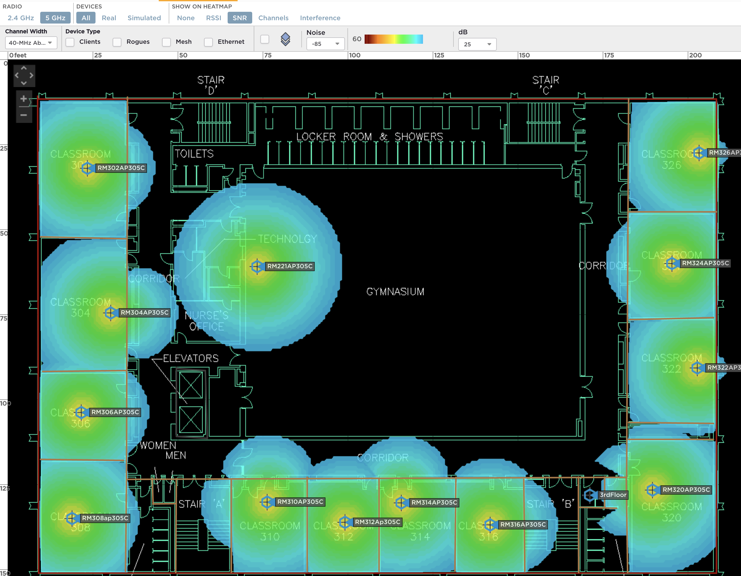
Performing a Site Survey (S/N)

Slide 48
Summary
How wireless networking benefits users and organizations
Standards in the IEEE 802.11 wireless family
WLAN security
Designing and laying out a WLAN network
Conducting a radio frequency (RF) site survey

